Slide 1

Agenda
Classes, objects & methods
OOPS Properties:
Abstraction
Encapsulation
Polymorphism
Inheritance
Constructor

Slide 2
Objects & Classes

Slide 3
objects
An real world entity that has state behavior and identity is known as object.
State
It is the data (value) of an object
Behavior
It is the functionality of an object
Identity
The object identity is typically implemented via a unique ID that is used internally by JVM

Slide 4
What is class?
A class is a blueprint from which objects are created .
A class describes state and behavior of an object
Syntax:
class <class_name> {
field;
method;
}

Slide 5
What is class?
A class may contain:
Fields
Syntax:
class <class_name> {
field;
method;
}
Methods
Constructors
Blocks
Nested class & Interface

Slide 6
Pcakage

Slide 7
What is Java Package?
A java package is a group of similar types of classes, interfaces and sub-packages.
Types of Package:
built in → comes along as a part of JDK to simplify the task of Java programmer.
user defined → developed by user in order to group related classes, interfaces, and sub packages.

Slide 8
Access Modifiers

Slide 9
What is Access Modifiers?
Modifier is a word or phrase or clause that describes, changes or modifies the meaning of another word or phrase in some ways.
Access modifiers helps to restrict the scope of a class, constructor, variable, method or data member.
Java provides number of access control modifiers to set access level for classes, variables, methods and constructors.
The four access levels are:
default
private
public
protected

Slide 10
Access Control Modifiers
default:
Visible to the package
private:
Visible to the class only
protected:
Visible to the package & all subclasses
public:
Visible to the world

Slide 11
Access Control Modifiers
Default
Public
Private
Protected
Same class | Yes | Yes | Yes | Yes
Same package subclass | Yes | Yes | No | Yes
Same package non sub class | Yes | Yes | No | Yes
Different package subclass | No | Yes | No | Yes
Different package non sub class | No | Yes | No | Yes

Slide 12
Java Methods

Slide 13
Java Methods
A method is a set of code that is grouped together to perform a specific operation.
A method must be written inside a class.
A class may have multiple methods.
Each method has its own signature.
A method returns a null or a value using the “return” statement
Java provides two types of methods
Predefined or standard Library Methods
User Defined Methods

Slide 14
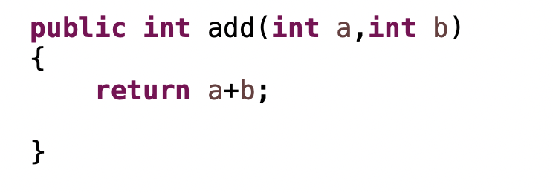
Java Methods - Syntax
Modifier – It defines the access type of the method
Name of Method – This is the method name
Return Type – Method may return a value
Parameter List (optional) – The list of parameters, it is the type, order, and number of parameters of a method
Method body – The method body defined what the method does with the statements

Slide 15
Scanner Class

Slide 16
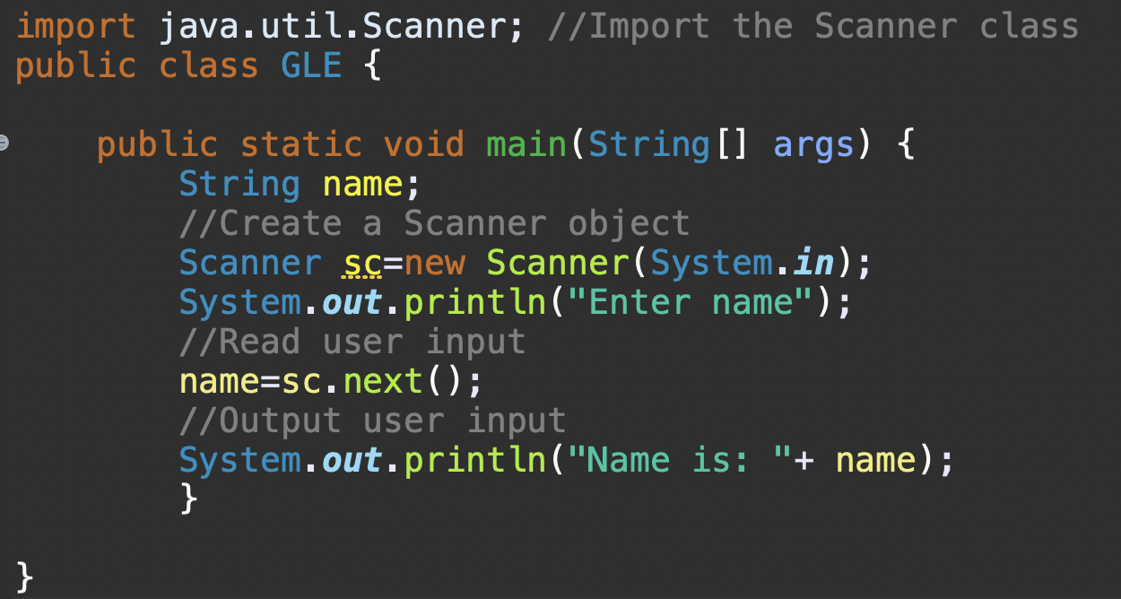
Scanner class
The Scanner class is mainly used to get the user input, and it belongs to the java.util package.
In order to use the Scanner class, you can create an object of the class and use any of the Scanner class methods.

Slide 17
Scanner class methods
There are various methods of Scanner class which can be used for various data types.
Method | Description
nextBoolean() | Reads a boolean value from the user
nextByte() | Reads a byte value from the user
nextDouble() | Reads a double value from the user
nextFloat() | Reads a float value from the user
nextInt() | Reads an integer value from the user
nextLine() | Reads a string value from the user
nextLong() | Reads a long value from the user
nextShort() | Reads a short value form the user

Slide 18
Java Program
Calculator Program
Multiplication
Addition
Division
Calculator
Subtraction
Interest
Square

Slide 19
Arrays

Slide 20
Arrays
An array is a data structure which holds the sequential elements of the same type.
Arrays are used to solve the problem of storing multiple elements of the same Datatype.
An array is a group of like-types variables, that referred by a common name.
Specific element in an array is accessed by it’s index
Array size is fixed and cannot be changed.
Array of any type can be created and may have one or more dimensions.

Slide 21
Arrays
Here array will be used to store marks of 4 subjects of a student
87 | 60 | 70 | 80
Value of elements
Every array starts with index 0
0 | 1 | 2 | 3
Index of elements
The elements from array can be accessed using their respective index

Slide 22
Array Declaration
Arrays are created either using new operator or by array initializer
new operator
array initializer
int [ ] a = new int [ 5 ] ;
int [ ] a = { 2, 4, 6, 8, 10 };
If the user tries to access index 5 then Java throws ArrayIndexOutOfBoundsException. That means Java says I do not understand beyond the index 4

Slide 23
Array Declaration
Different ways of declaring Arrays
int a [ ] = new int [ 5 ] ;
int [ ] d = new int [ ] { 1, 2, 3, 4, 5 } ;
int [ ] b = new int [ 5 ] ;
int [ ] c = { 2, 4, 6, 8, 10 };
The length of an array is set , when it is declared
When an array is declared, array index is get initialized.

Slide 24
Types of Arrays

Slide 25
Types of Arrays
Single Dimensional Array
int [ ] a = { 2, 4, 6, 8, 10 };
value
2 | 4 | 6 | 8 | 10
index
a [0] | a [1] | a [2] | a [3] | a [4]

Slide 26
Types of Arrays
Multi Dimensional Array
int [ ] [ ] a = new int [ 5] [ 5] ;
a = [ 1] [ 3] ;
X value indicates row number
Y value indicates column number

Slide 27
Arrays – Memory Allocation
Single Dimensional Array
Multi Dimensional Array
int a [ ] = new int [ 5 ] ;
int [ ] [ ] a = new int [ 5] [ 5] ;
As we know, integer value requires 4 Bytes to allocate a variable in memory. So, to allocate an array of 5 elements in memory 4*5 = 20 Bytes are required.
Total number of elements in given Multi Dimensional Array = 5*5=25. So, 25*4=100 Bytes are required to allocate these elements in memory.

Slide 28
Array Program
Create an array of objects of the Student class, of size 3. The Student class is defined below. Create three objects of the Student class, with values, and assign the objects to the array. Loop through the array and print the name, grade, and email of all students as below:
Peter 3 p@gmail.com
John 4 j@gmail.com
Lisa 5 l@gmail.com

Slide 29
Strings

Slide 30
Strings in Java
Java String is a sequence of characters.
They are objects of type String class.
Once a String object is created, it cannot be changed. Strings are immutable.

Slide 31
Immutability of Strings
Java String are immutable for several reasons.
Security: Strings are used for network connection and for database connection. To avoid the access to these connections from external users, Strings are immutable.
Synchronization: Immutability of Strings automatically makes system thread safe to solve the synchronization problem.
Caching: If two String objects are having the same value, and you need only one string, then the two objects will point to the same memory location pointing same String object.

Slide 32
Constructor

Slide 33
What is A Constructor?
Constructor is used in the creation of an object
It is the block of code used to initialize an object
Constructor must have the same name as the class it is in, and it does not have any return type.
Constructor gets executed when an object of a class is being created.
Constructors are of two types
Default Constructor
Parameterized Constructor

Slide 34
Rules for using Constructors
The name of the constructor should be same as that of the class name.
A constructor can not be declared as final, static, synchronized or abstract.
It cannot have an explicit return type.
A constructor can have an access modifier to control the access.

Slide 35
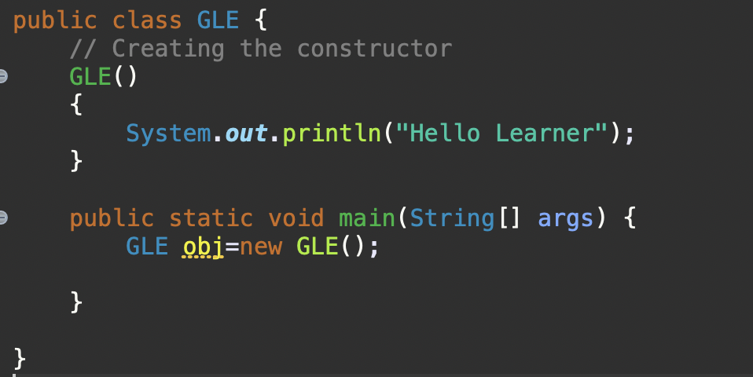
Default Constructor
A constructor with no arguments is called a default constructor.
If we do not create a constructor of a class, Java creates a default constructor with data members which has values like zero, null, etc.
But, if we specify a constructor with no arguments, it will be a default constructor or a no argument constructor which is another name for default constructor.

Slide 36
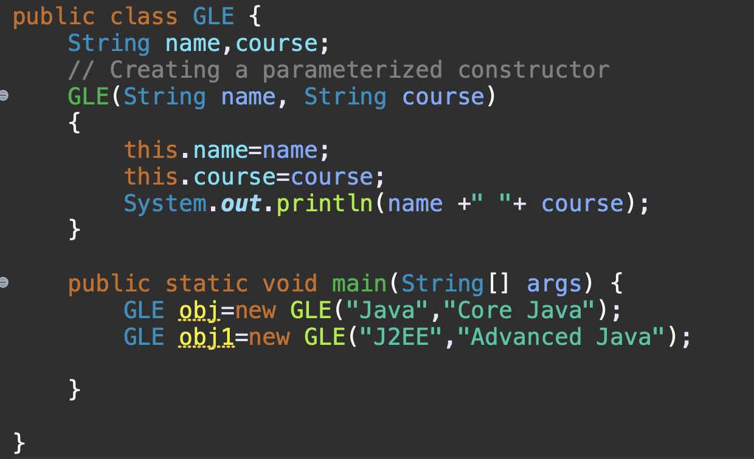
Parameterized Constructor
A constructor which has arguments is called as a parametrized constructor.
It is used to assign values to distinct objects.

Slide 37
this keyword
this keyword in Java represents the current instance of a class.
It is mainly used to access other members of the same class.
The main motto of using this keyword is to differentiate the formal parameter and data members of the class.
If in case, the formal parameter and data members of the class are the same, then it leads to ambiguity.
So, in order to differentiate between formal parameter and data member of the class, the data member of the class must be preceded by the “this” keyword.
this keyword can be used in two ways:
this
this ()

Slide 38
this keyword
this
It can be used to differentiate variable of the class and formal parameters of method or constructor.
Not only that, but it also always points to the current class object.
2. this ()
It can be used to call one constructor within another without creating the objects multiple times for the same class.

Slide 39
Constructor v/s Method
Constructor name has to be same as class name.
Constructor does not have a return type.
Constructor is called when an object is created.
Method name need not be same as the class name.
Method has a return type.
You can call a method any number of times.

Slide 40
OOPs Concepts

Slide 41
OOPs Concepts
OOPs has four main components.
Abstraction
Encapsulation
Inheritance
Polymorphism

Slide 42
Abstraction

Slide 43
Abstraction
Abstraction provides defined conceptual boundaries relative to the perspective of the viewer.
Abstraction denotes the essential characteristics of an object that distinguish it from all other kinds of objects.
It emphasizes on details that are significant to the viewer and suppress details that do not matter.
We can achieve abstraction in java in two different ways
Abstract Class
Interface

Slide 44
Summary of Abstraction
Hides the underlying complexity of data
Helps avoid repetitive code
Presents only the signature of internal functionality
Gives flexibility to programmers to change the implementation of abstract behavior
Partial abstraction (0-100%) can be achieved with abstract classes
Total abstraction (100%) can be achieved with interfaces

Slide 45
Encapsulation

Slide 46
Encapsulation
Encapsulation is the process of compartmentalizing the elements of an abstraction.
It is the mechanism for restricting access to some components of an object.
It is achieved by declaring the variables of a class as private and then providing the public setter and getter methods to modify and view the variable values.

Slide 47
Encapsulation - Example
Person Object
Object – representing a person
Data members – name and age
Accessible to outside world
name
age

Slide 48
Encapsulation - Example
Other objects can change the values using the data members directly.
p1.name = “John” ;
p1.age = 20 ;
p1.name = “jack 1234………..” ;
p1.age = 2000 ;
(p1) Person Object
name
age

Slide 49
Encapsulation - Example
Solution – Encapsulation
Hide data members
Expose setters/getters
setName and setAge are functions.
They can validate the input, before
assigning to target members
(p1) Person Object
setName
name
getName
setAge
age
getAge
Public void setAge (int age) {
If ( age < 1 || age > 100) {
throw new InvalidAgeException ( );
}
this.age = age
}

Slide 50
Summary of Encapsulation
Restricts direct access to data members (fields) of a class
Fields are set to private
Each field has a getter and setter method
Getter methods return the field
Setter methods let us change the value of the field

Slide 51
Inheritance

Slide 52
Inheritance
Inheritance allows a sub-class to inherit the properties of parent class.
The properties of one or multiple parent class can be inherited.
Code reusability is the main objective of inheritance.
Inheritance represents the IS – A relationship which is also known as parent – child relationship.
Syntax:
class Subclass extends Superclass
{
//methods and fields
}

Slide 53
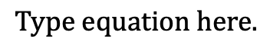
Types of Inheritance
single Inheritance
✅
Multilevel Inheritance
✅
Inheritance
Multiple Inheritance
Hierarchical Inheritance
✅
Hybrid Inheritance
✅

Slide 54
Single Inheritance
Single level inheritance enables a derived class to inherit properties and behavior from a single parent class.
class A
class B

Slide 55
Multiple Inheritance
Multi level inheritance enables a derived class to inherit properties and behavior from a parent class which is also derived from another class.
class A
class B
class C

Slide 56
Hierarchical Inheritance
Hierarchical level inheritance enables more than one derived class to inherit properties and behavior from a parent class.
class A
class B
class C
class D

Slide 57
Hybrid Inheritance
Hybrid inheritance is a combination of one or more inheritance.
class A
class B
class C
class D
class E
class F

Slide 58
Multiple Inheritance
There is also another possibility in inheritance called as Multiple inheritance.
It is not supported in Java and results in an ambiguity called as Diamond problem
class A
class B
class C
class D

Slide 59
Summary of Inheritance
A class (child class) can extend another class (parent class) by inheriting its features
Implements the DRY (Don’t Repeat Yourself) programming principle
Improves code reusability
Multi-level inheritance is allowed in Java (a child class can have its own child class as well)
Multiple inheritances are not allowed in Java (a class can’t extend more than one class)

Slide 60
Polymorphism

Slide 61
Polymorphism
Polymorphism is the property of an object which allows it to take multiple forms.
Compile Time
It is resolved during compiler time.
Overloading is an example of compile time polymorphism
Types of Polymorphism
It is resolved during run time.
Overriding is an example of compile time polymorphism
Run Time

Slide 62

What is Polymorphism
Polymorphism is the just the ability of a method to behave differently at different situation, and this is achieved either by Method Overloading or by Method Overriding.

Slide 63



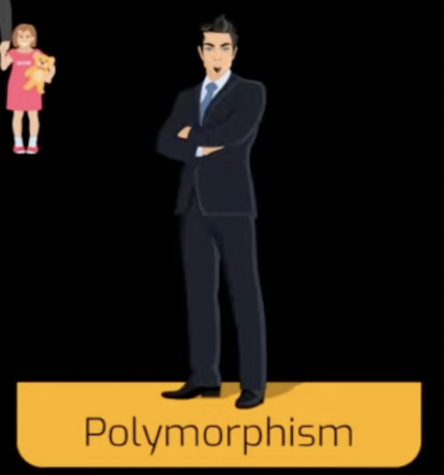



Example of Polymorphism

Slide 64
Polymorphism in Java
in Java, there may be situation where you need to write multiple methods with same name (because they all do same job) but they behave differently based on the parameters supplied. Example: getArea(int radius) { return 3.14 * radius * radius; } used to calculate area of Circle.
getArea(int length, int breadth) { return length * bredth; } used to calculate area of Rectangle.

Slide 65
Types of Polymorphism

Slide 66
Types of Polymorphism
Static Polymorphism
Dynamic Polymorphism

Slide 67
Static Polymorphism
A polymorphism that is resolved during compile time is known as static polymorphism.
Method overloading is an example of compile time polymorphism.

Slide 68
Method Overloading

Slide 69
Method Overloading
Method overloading is a feature that allows a class to have more than one method having the same name with different argument lists.
You can overload the method in three ways:
Number of parameters
Datatype of the parameters
Sequence of the datatype of the parameters

Slide 70
Classic Example of Method Overloading
You might have used "System.out.println()" method and passed int, float, String, Object etc as a parameter like,
System.out.println(10) -> 10
System.out.println("hello") -> hello
System.out.println(50.5) -> 50.5
Same method name println(), can print integer, float, String etc. this happens with method overloading because "println" method is overloaded.

Slide 71
Constructor Overloading

Slide 72
Constructor Overloading
Just like method overloading, constructors can be overloaded to create objects in different ways.
The compiler differentiates constructors based on how many arguments are present in the constructor and other parameters like the order in which the arguments are passed.

Slide 73
Dynamic Polymorphism
A polymorphism that is resolved during run time is known as dynamic polymorphism.
Method overriding is an example of run time polymorphism.

Slide 74
Method Overriding

Slide 75
Method Overriding
Method overriding is a feature that allows the parent class and sub class to have a same method.
Rules of Method Overriding:
The argument list of the child class should match the parent class.
Access modifier of the child class should be less restrictive than the parent class.
Local parameters can not be overridden.

Slide 76
Rules of Method Overriding
Parameters that need to be consider in case of Method Overriding,
Access Specifier of method
Return Type of method
Name of method
Arguments/Parameters of method
Exception that method throws.

Slide 77
Rules of Method Overriding
Access Specifier of method
Overriding method in Child class can either have same access specifier as that of Parent class method or can increase visibility but cannot decrease it. If Parent class method is declared as,
then valid access specifier for Child class overriding method connect() is,
protected void connect ( );
public void connect ( );
protected void connect ( );

Slide 78
Rules of Method Overriding
Return type of method
Overriding method in Child class can either have same return type or should be Subclass of return type declared in method of Super class. If Parent class method is declared as,
then valid Return type for overriding connect() method in Child class is either Number class or all subclass of Number class,
protected Number connect ( );
public Integer connect ( );
protected Long connect ( );
protected Number connect ( );

Slide 79
Rules of Method Overriding
Name of method
Name of the overriding method in Child class must be exactly same as that of method declared in Parent Class

Slide 80
Rules of Method Overriding
Arguments/Parameters of method
Total number and Type of arguments present in overriding Child class method must be exactly same as that of Parent class method.

Slide 81
Rules of Method Overriding
Exception that method throws
Unchecked Exception: Overriding method in Child class can throw any number of Unchecked Exception irrespective of Parent class overridden method has declared any Checked/Unchecked Exception or not.
Checked Exception: If say Overridden method of Parent class throws IOException, then overriding method in Child class can either throw
No Exception,
Same IOException,
Any number of Subclass of IOException like FileNotFoundException, EOFException etc.

Slide 82


Characteristics of Polymorphism
Coercion

Slide 83
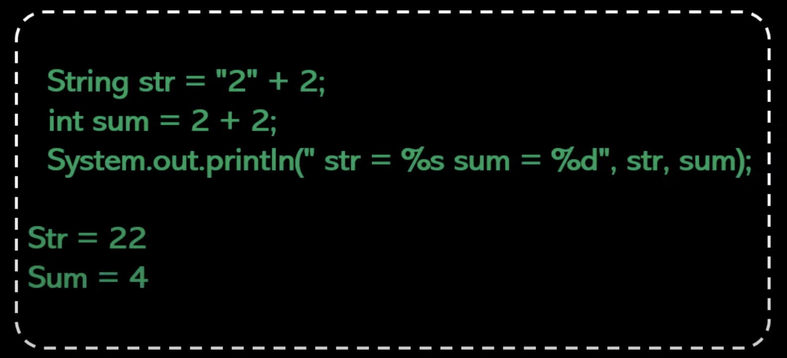
Characteristics of Polymorphism
Operator Overloading

Slide 84
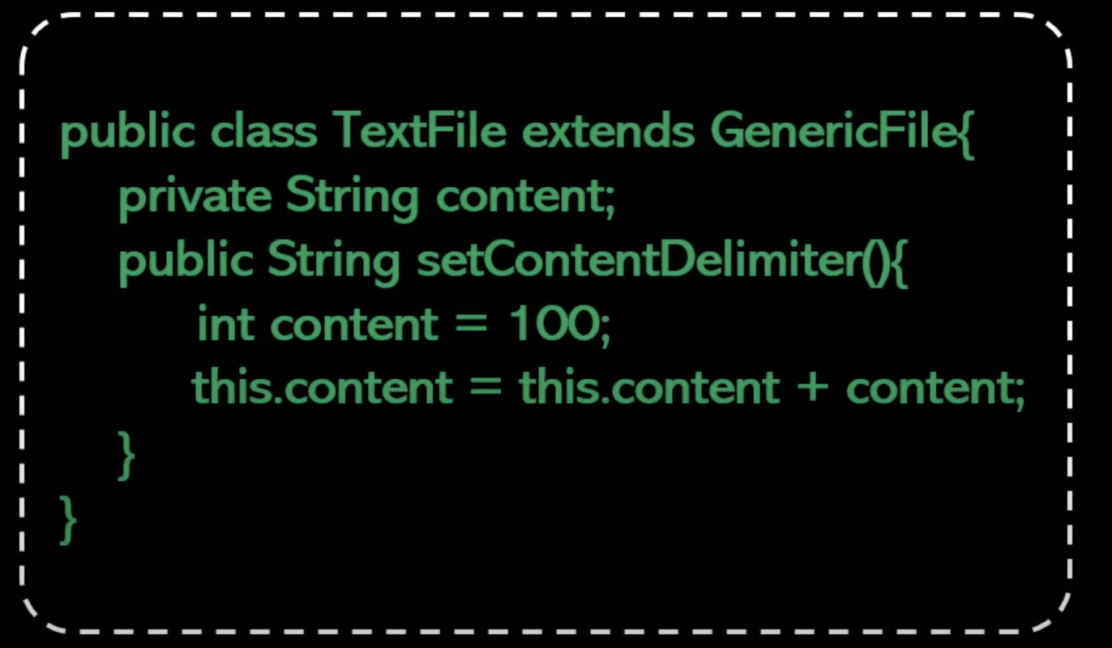
Characteristics of Polymorphism
Polymorphic Parameters

Slide 85
Super Keyword
Super is a keyword. It is used inside a subclass method definition to call a method defined in the super class.

Slide 86
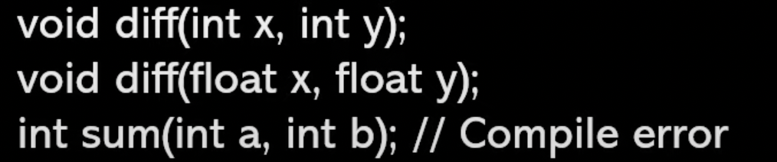
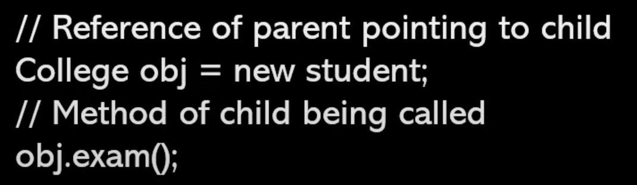
Static v/s Dynamic Polymorphism
Static polymorphism relates to Method Overloading.
Errors are resolved at compile-time
Dynamic polymorphism relates to Method Overriding.
Errors can only be determined at run-time.

Slide 87
Advantages of Polymorphism
Programmer's code can be reused via Polymorphism.
Supports single variable name for multiple datatypes.
Reduces coupling between different functionalities.

Slide 88
Disadvantages of Polymorphism
Polymorphism ends up raising performance issues in real-time.
Polymorphism reduces readability of the code.
Programmers find Polymorphism difficult to implement.

Slide 89
Summary of Polymorphism
The same method name is used several times
Different methods of the same name can be called from an object
All Java objects can be considered polymorphic (at the minimum, they are of their own type and instances of the Object class)
Static polymorphism in Java is implemented by method overloading
Dynamic polymorphism in Java is implemented by method overriding

Slide 90
Program
There is a car, which has attributes model and price, and the car has functionalities start, stop and move. Also, there is a driver, having attributes name and age, and the behavior drive.
Model the classes Car and Driver. You need to take care of the accessibility of the attributes from outside the class for the best design.

Slide 91
Program
ENJOY COFFEE IN THE CAR! – (use of All OOPs concepts in one program)
The application is: Choose your luxury car and enjoy coffee or tea as per your choice while driving.

Slide 92

Thank You

